Slide 1
Quickway Safety Forum
Prevention & Management of Soft-tissue and Joint Injury
Paul Monaro
Sport & Spine Physiotherapist

Slide 2
Background
Paul Monaro
- Degree in Physiotherapy, University of Sydney, 1986
Post-Graduate qualifications in Spinal and in Sports Physiotherapy.
27 years running private practice
50% case load is low back pain
High case load of shoulder and knee injuries

Slide 3
Construction Industry Experience
High Case Load
Research
Consultancy re Injury Prevention
Design of Morning Warm-up
Education Supervisors and Trainees
Musculoskeletal Screening

Slide 4
Musculoskeletal Screening

Slide 5
Musculoskeletal Screening
Results:
low back endurance for the group was on average 70% of healthy average = potential risk for LBP.
Other endurance test scores: thigh endurance 48%; side abs 64%; front abs 64%

Slide 6
Incidence of LBP in Construction Workers
In the general population, the lifetime incidence of LBP is 80%, while for construction workers the lifetime incidence is 90%. (Perich et al 2011)
The incidence of LBP was found to be 50% higher in construction workers than in other industrial workers. (Adams & Hutton, 1981)
In injury surveys, up to 66% of construction workers had suffered from LBP in the previous 12 months and over 30% had experienced LBP during the previous week.
(Ergonomics Manual for Mason Tenders, 2000; Goldsheyder et al 2004)
In apprentice construction workers, 54.4% reported injuries to the lower back.
(Merlino et al 2003)

Slide 7
Incidence of LBP
2rd most common cause work sick days (behind cold & flu) (Steenstra et al 2013)
WC patients with LBP had average 17 days off work; those with LBP & ‘sciatica’, av. 48 days
Mahmud et al 2000)

Slide 8
What is back pain?
Part of life
Part of construction work – 90% of workers
Injuries are generally not serious and recovery is mostly quick
Something to be respected & ‘worked around’
Aim to minimise stress where possible

Slide 9
What is a back Injury?
A sprain or strain
Can affect discs, joint, ligament, muscles, or nerves
Pain does not always mean damage
Some back pain is inevitable in construction work

Slide 10
How disabling is a back Injury?
A physical injury influenced by
Cultural
Social
Psychological
Physical problem but always with psychological consequences

Slide 11
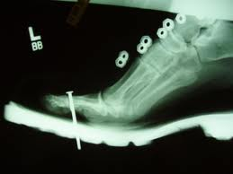
What is a back Injury?
Psychological influences
Examples:
Mother with 8 children – “I’m going to end up in a wheelchair!”
Ambulance for acute low back pain
Nail gun accident

Slide 12
Physical Causes of Back Pain

Slide 13
Bending - Repetitive - Sustained

Slide 14
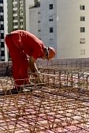
Prolonged or repetitive bending:
- Muscles switch off.
20 minutes of slouched
sitting or full bending
resulted in muscle
‘shut-down’ for over
7 hours
(Jackson et al 2001)

Slide 15
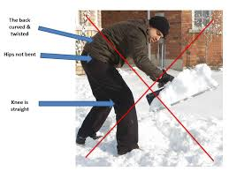
Bending & Twisting

Slide 16
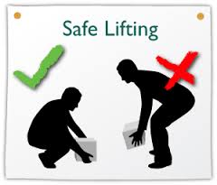
Lifting
(Mawston & Boocock 2012)

Slide 17
What are the Dangers to our Backs?
Lifting
Poor technique / wrong for situation
Off the ground
Load and size of object
Lowering: Research shows that up to 2/3 of lifting-related injuries come from lowering rather than lifting a load

Slide 18
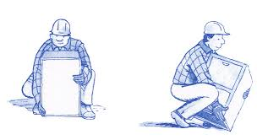
Why Do We Bend Our Knees?
Squat lifting - sometimes

Slide 19
Problems with Bending from the Knees
Off balance – can’t lift heavy weights
A lot of people bend the back more
Strain on the knees

Slide 20
How Do We Bend?
The answer:
There is no 1 correct way.
Varies for each situation
Varies for each person
Prevent injury by developing expertise / constantly adapting to each different situation.
Master bending from the hips and keeping the back straight.

Slide 21
What are the Dangers to our Backs?
Research also shows that up to 20% of back injuries occur with pushing or pulling an object or load

Slide 22
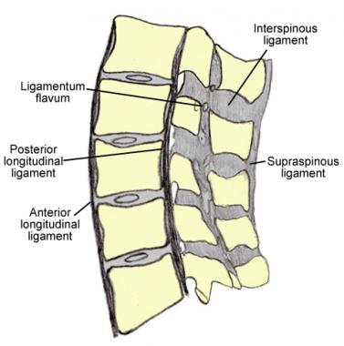
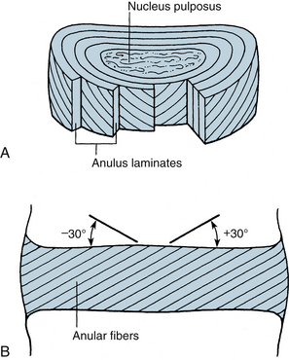
What is injured?
Bending / twisting

Slide 23
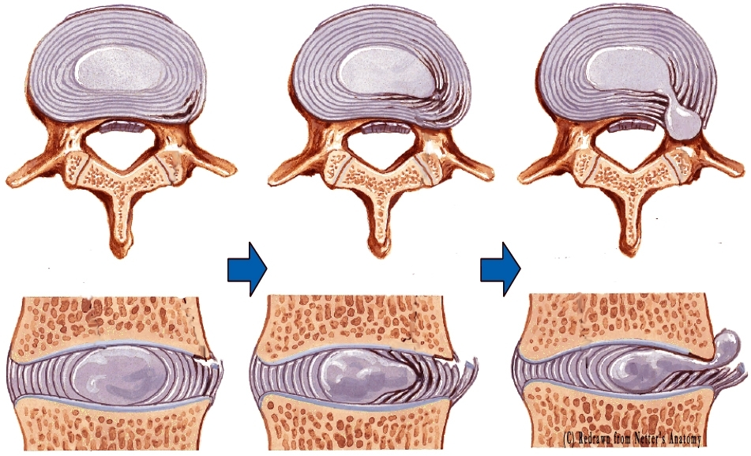
What is injured?
Prolonged or repetitive bending:
What happens in the disc? ‘Bulge concept’.

Slide 25
Individual Causes of Back Injury

Slide 26
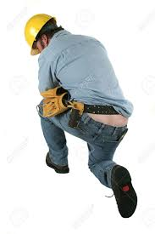
Poor fitness / back muscle endurance
Poor flexibility
Tight clothes
Equipment – Tool belts; Reel
Too much flexibility in back / poor technique (see below)

Slide 27
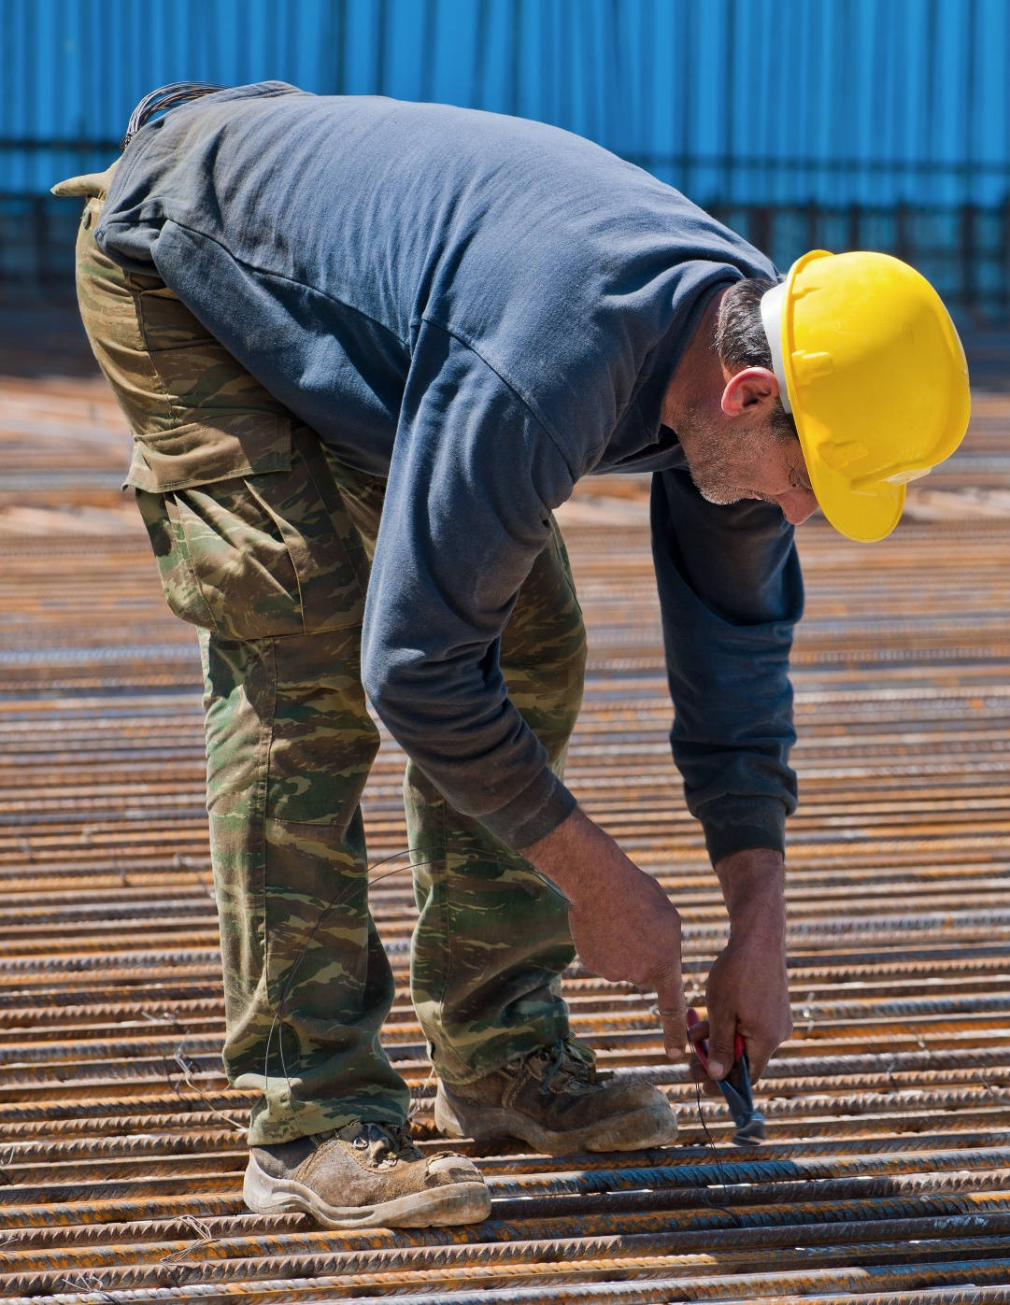

Slide 28
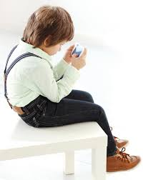
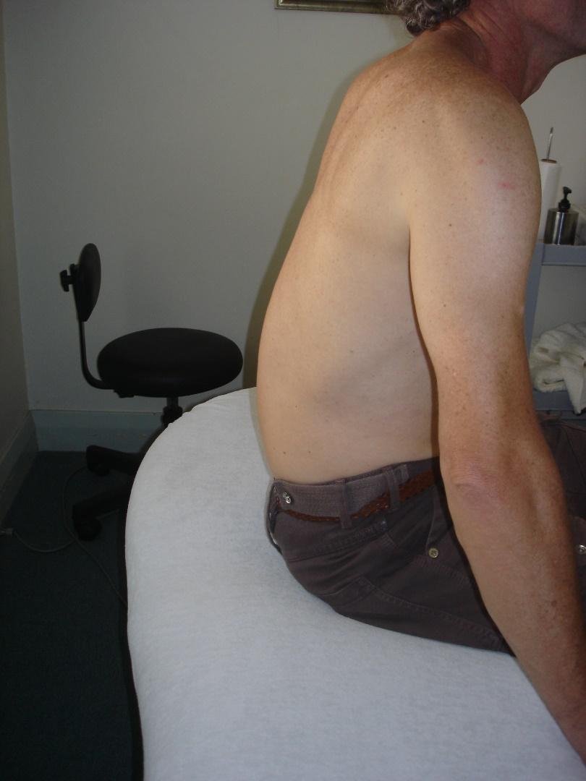
Individual Causes
Prolonged sitting
How we sit determines how we move
A study of apprentice construction
workers showed that those who
adopted sedentary postures
outside of work had a three
times greater risk for
developing work-related LBP
(Merlino et al 2003)

Slide 29
Individual causes
First 1 – 2 hours in the morning
Discs swollen with fluid, more vulnerable to bending injury.
Drive to work
Drive Home

Slide 30
Problems with Incorrect or Prolonged Bending
Discs – ‘bulge’
Ligaments – ‘creep’
Over-bending early means
stress is carried throughout
the movement.
Muscles – ‘off-switch’

Slide 31
Which is worse?

Slide 32
Individual Causes
Fatigue
Muscles less supportive
Movements become ‘lazy’
Revert to old habits

Slide 33
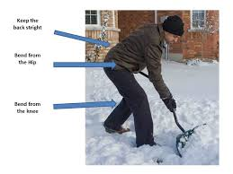

Slide 34
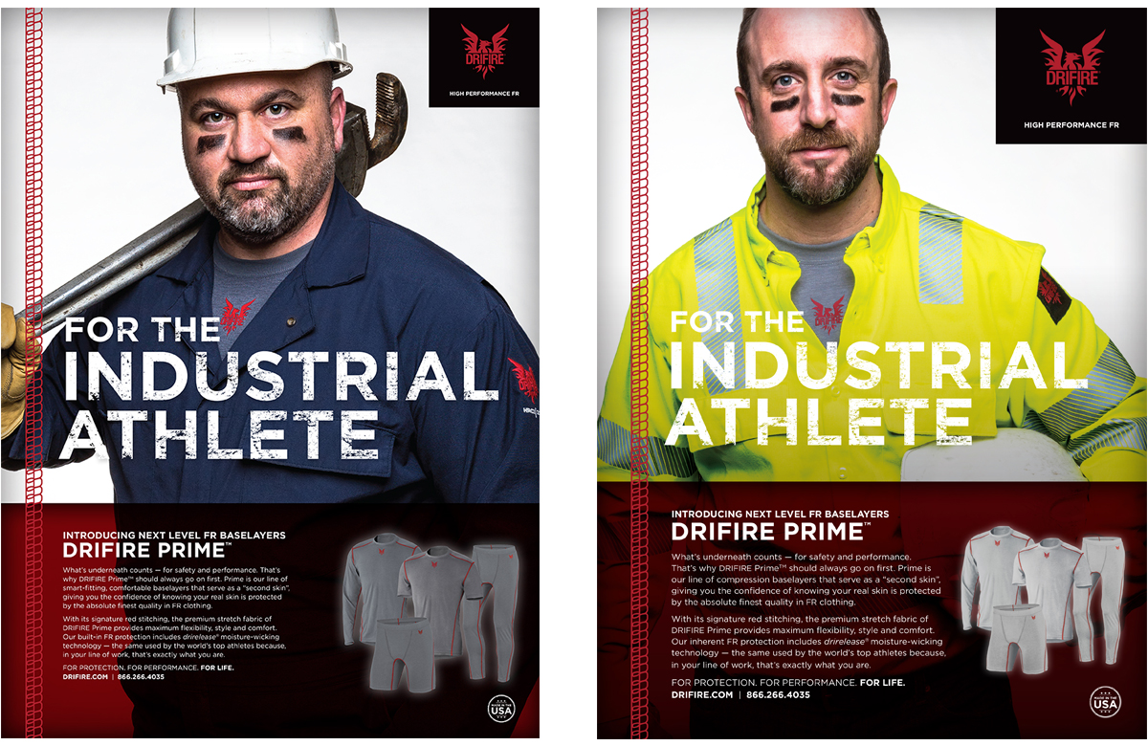
What Are The Solutions?
Being work ready – warm-up (not stretching)
Fitness for work

Slide 35
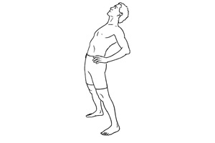
Counteracting the ‘bulge’
Regular
straightening and
arching the back
Don’t arch fully
Keep muscles relaxed

Slide 36
What Are The Solutions?
Regular change of position
Rotating jobs
Good technique
Physical Fitness for the job – workers responsibility

Slide 37
What Are The Solutions?
Care in the morning
Risk of bending / lifting straight after drive to work
Change of position / job, especially end of shift or when tired.

Slide 38
What Are The Solutions?
Technique
Practice
Adaptability
Variation for each task
Load close to Centre of Gravity
Identify positions that are most common & demanding – look for solutions

Slide 39
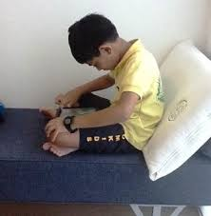
What are the Solutions?
What do you do outside of work?

Slide 40
What should a worker do if they Injure their back?
First few days important:
Notify supervisor
Temporary avoidance of bending / lifting
Minimal sitting
Walking / stay active
Not too much bed rest, except to sleep
Seek expert advice / positive outlook / early RTW

Slide 41
How much time off work?
How much time off work?
10% LBP / 25% LBP & sciatica still off work at 3 months (Anderson et al 1983)
By 3-4 weeks off work there is a 10 to 20% risk of long-term incapacity (Waddell 2004)
Essentially, the longer a person is off work with LBP, the lower the chance they will ever return - There is a “disastrous impact of prolonged time off work” (Krause et al 1999; Waddell 2004)

Slide 42
How much time off work?
On the flip-side, recovery was found to be significantly quicker when
Early RTW programme implemented
Health care practitioner encouraged early return and gave optimistic prognosis
Patient undertook a work rehabilitation programme
(Steenstra et al 2015)

Slide 43
Who are the at risk workers?
Past history LBP, especially if time off work (Watson et al 1998)
Any past injury with substantial time off work (Turner et al 2008)
Psychosocial factors (may be apparent later)
Poor job satisfaction (Steenstra et al 2013; Turner et al 2008)
Poor general health, other injuries (Nordin et al 2002; Turner et al 2008)
Older age (experienced) (Steenstra et al 2015)
Inexperienced
Those given inappropriate advice from health care provider (extended time off)

Slide 44
It’s Not Just About the Back
30 to 40% of construction workers develop neck, mid-back or shoulder problems.
(Holmstrom et al 1992)
Hands / wrists – repetitive use of hand tools; lack of protective equipment or guards.
Knees

Slide 45
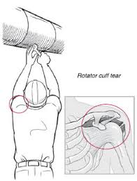
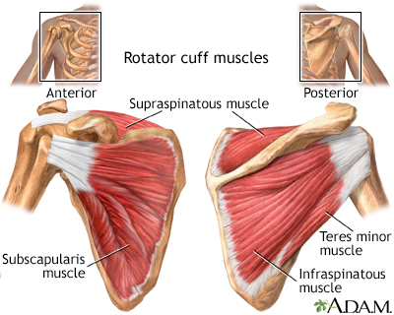
Shoulders
Long Levers
Prolonged working overhead
Shoulders & neck vulnerable “Rotator cuff”
Back also

Slide 46
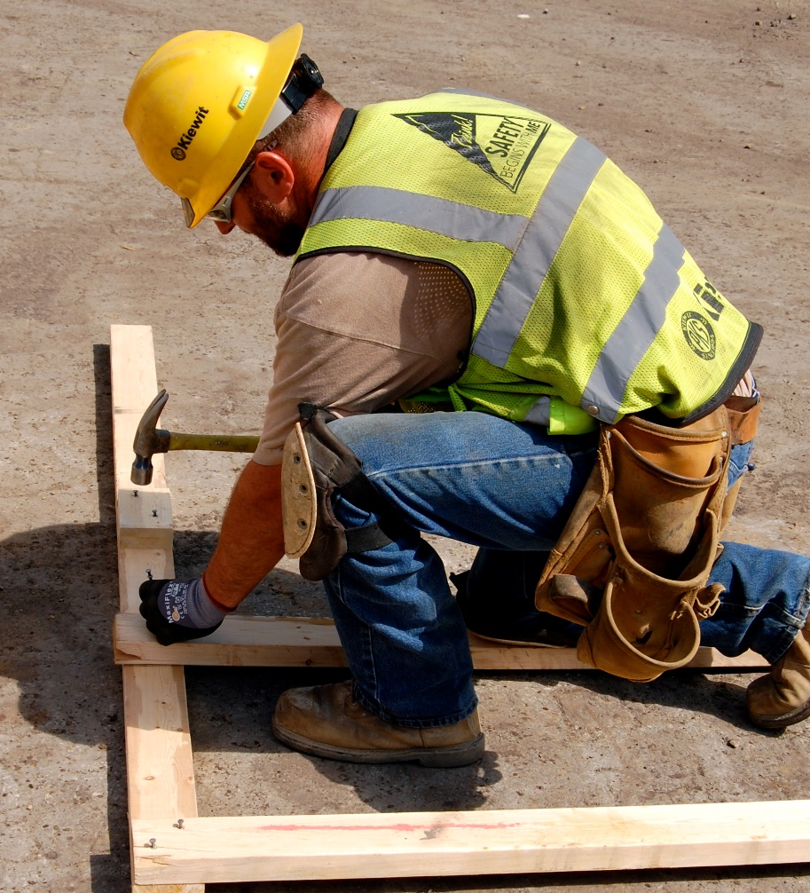
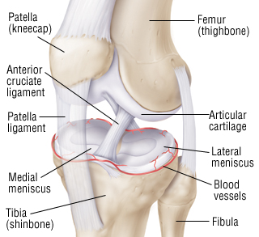
Knees Knee-cap joint and meniscus
Kneeling
Squatting
Protecting the back!
Knee pads

Slide 47
RICE
Rest Variable!!
Ice 20 min every 1-2 hours, 2-3 days
Compression Bandage / strapping
Elevation

